Slide 1
TBL 3rd week

Slide 2
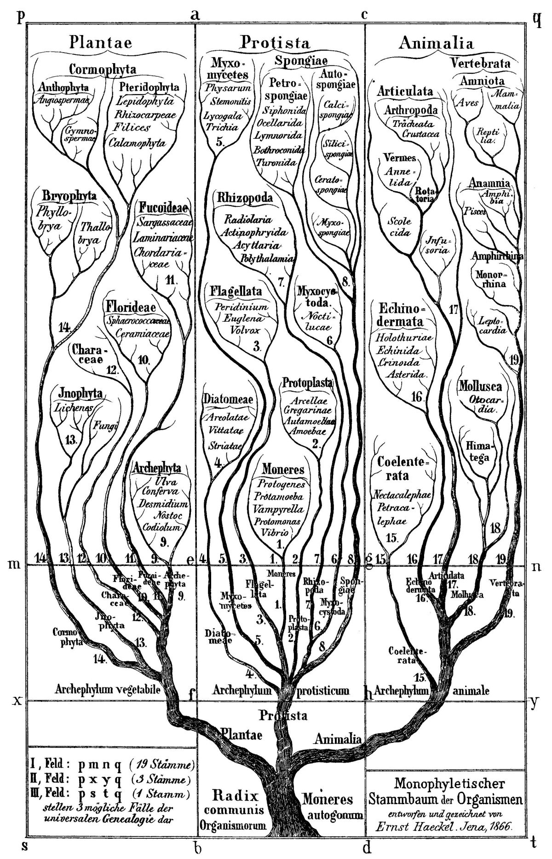
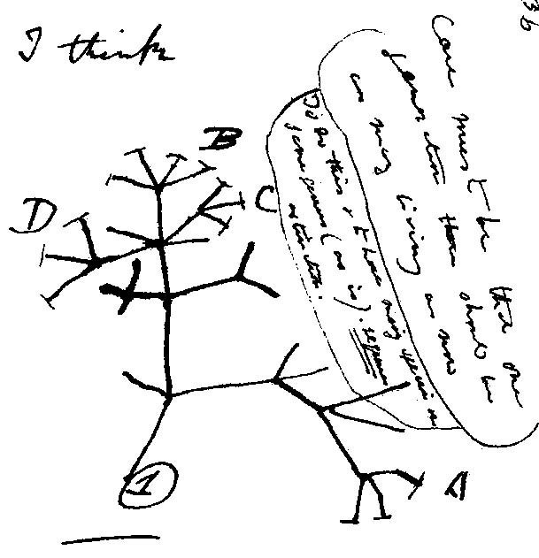
How are trees of life found in the religions and the philosophies of many different cultures different from evolutionary tree? (Are they different?)

Slide 3
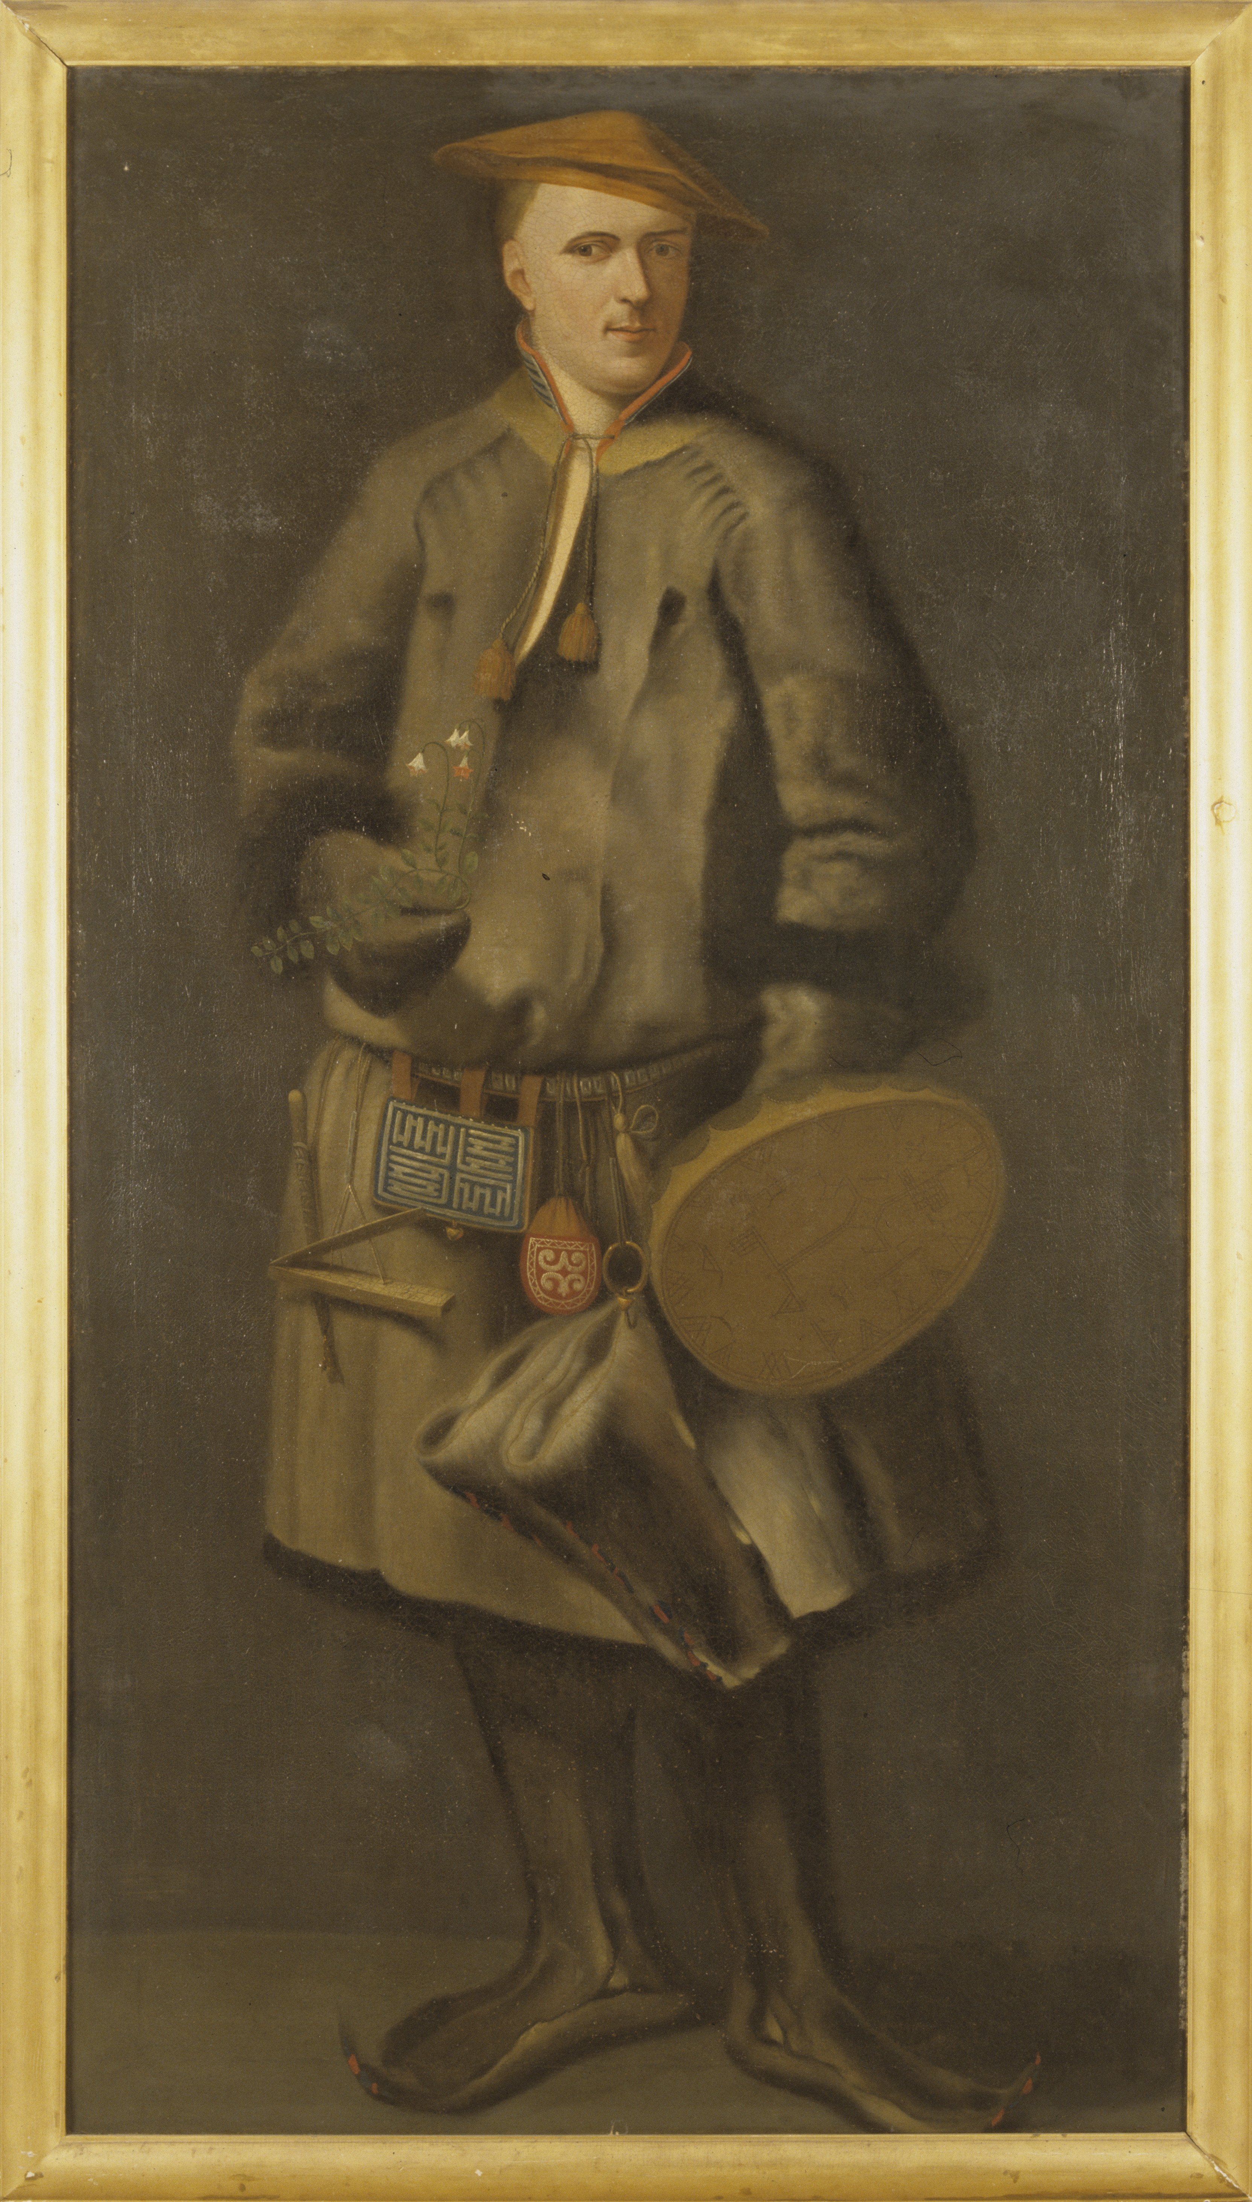
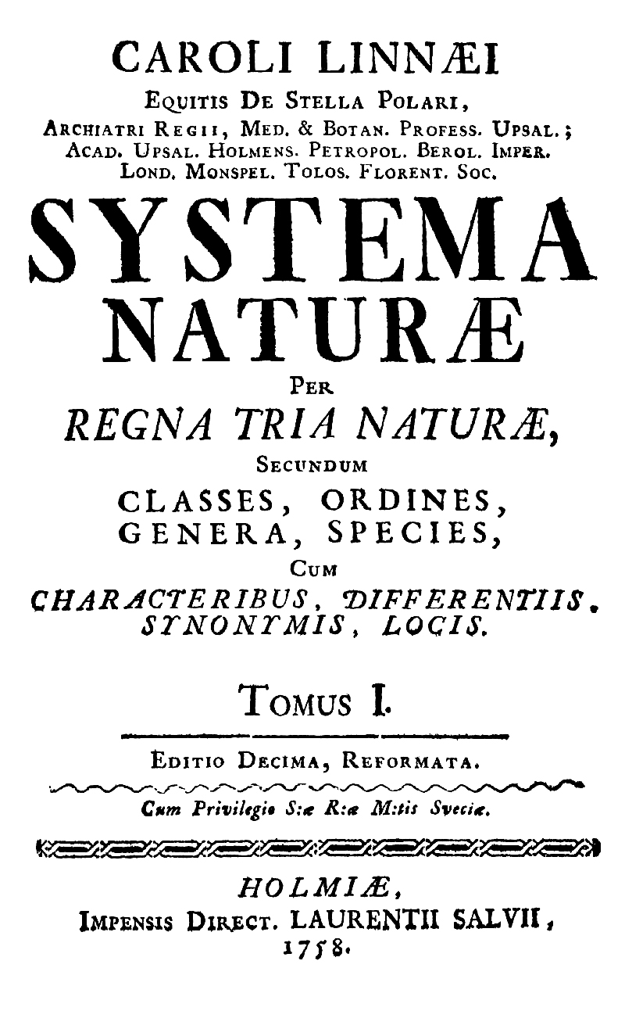
Some classification systems are tree like (hierarchical); however, their creators did not imply a history of shared descent. E.g., Carl von Linné’s taxonomic system
Linne thought species to be largely immutable. For example, while he placed humans with apes into a group called primates (and was criticized for it), Linne did not imply a common origin of that group.
From: https://en.wikipedia.org/wiki/Carl_Linnaeus

Slide 4
How are trees of life found in the religion and the philosophy of many different cultures (1) different from evolutionary tree (2)?
A) Trees of life (1) usually are not intended to depict shared ancestry
B) Only evolutionary trees (2) do accurately depict diversity
C) Both types of tree have been used to classify organisms.
D) A, B, and C are correct
E) Only A and C are correct
Q 1
Notes:
A, B, and C are correct

Slide 5
How are family genealogies or pedigrees different or similar from a tree depicting species evolution?
In a genealogy an individual node has many ancestor, in an evolutionary tree one species can have many decedents.
Both depict the ancestry of either an individual or a species
In both cases only a subset of genetic information is passed from parent or parent species to the next generations / descendent species
A, B and C is correct
A, B is correct
Q 2
Notes:
A, B and C is correct

Slide 6
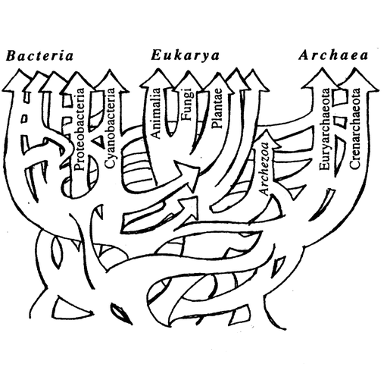
Ford Doolittle, one of my fellow horsemen of the gene transfer apocalypse, published this sketch of phylogenetic relations.
What do you think this image tries to communicate?
Different groups of organisms were not derived from single ancestors
The Last Universal Common Ancestor was not a single organism, but a population
A single tree doesn’t give a good description of evolutionary history.
A and C are correct.
All of the above.
Notes:
All of the above.

Slide 7
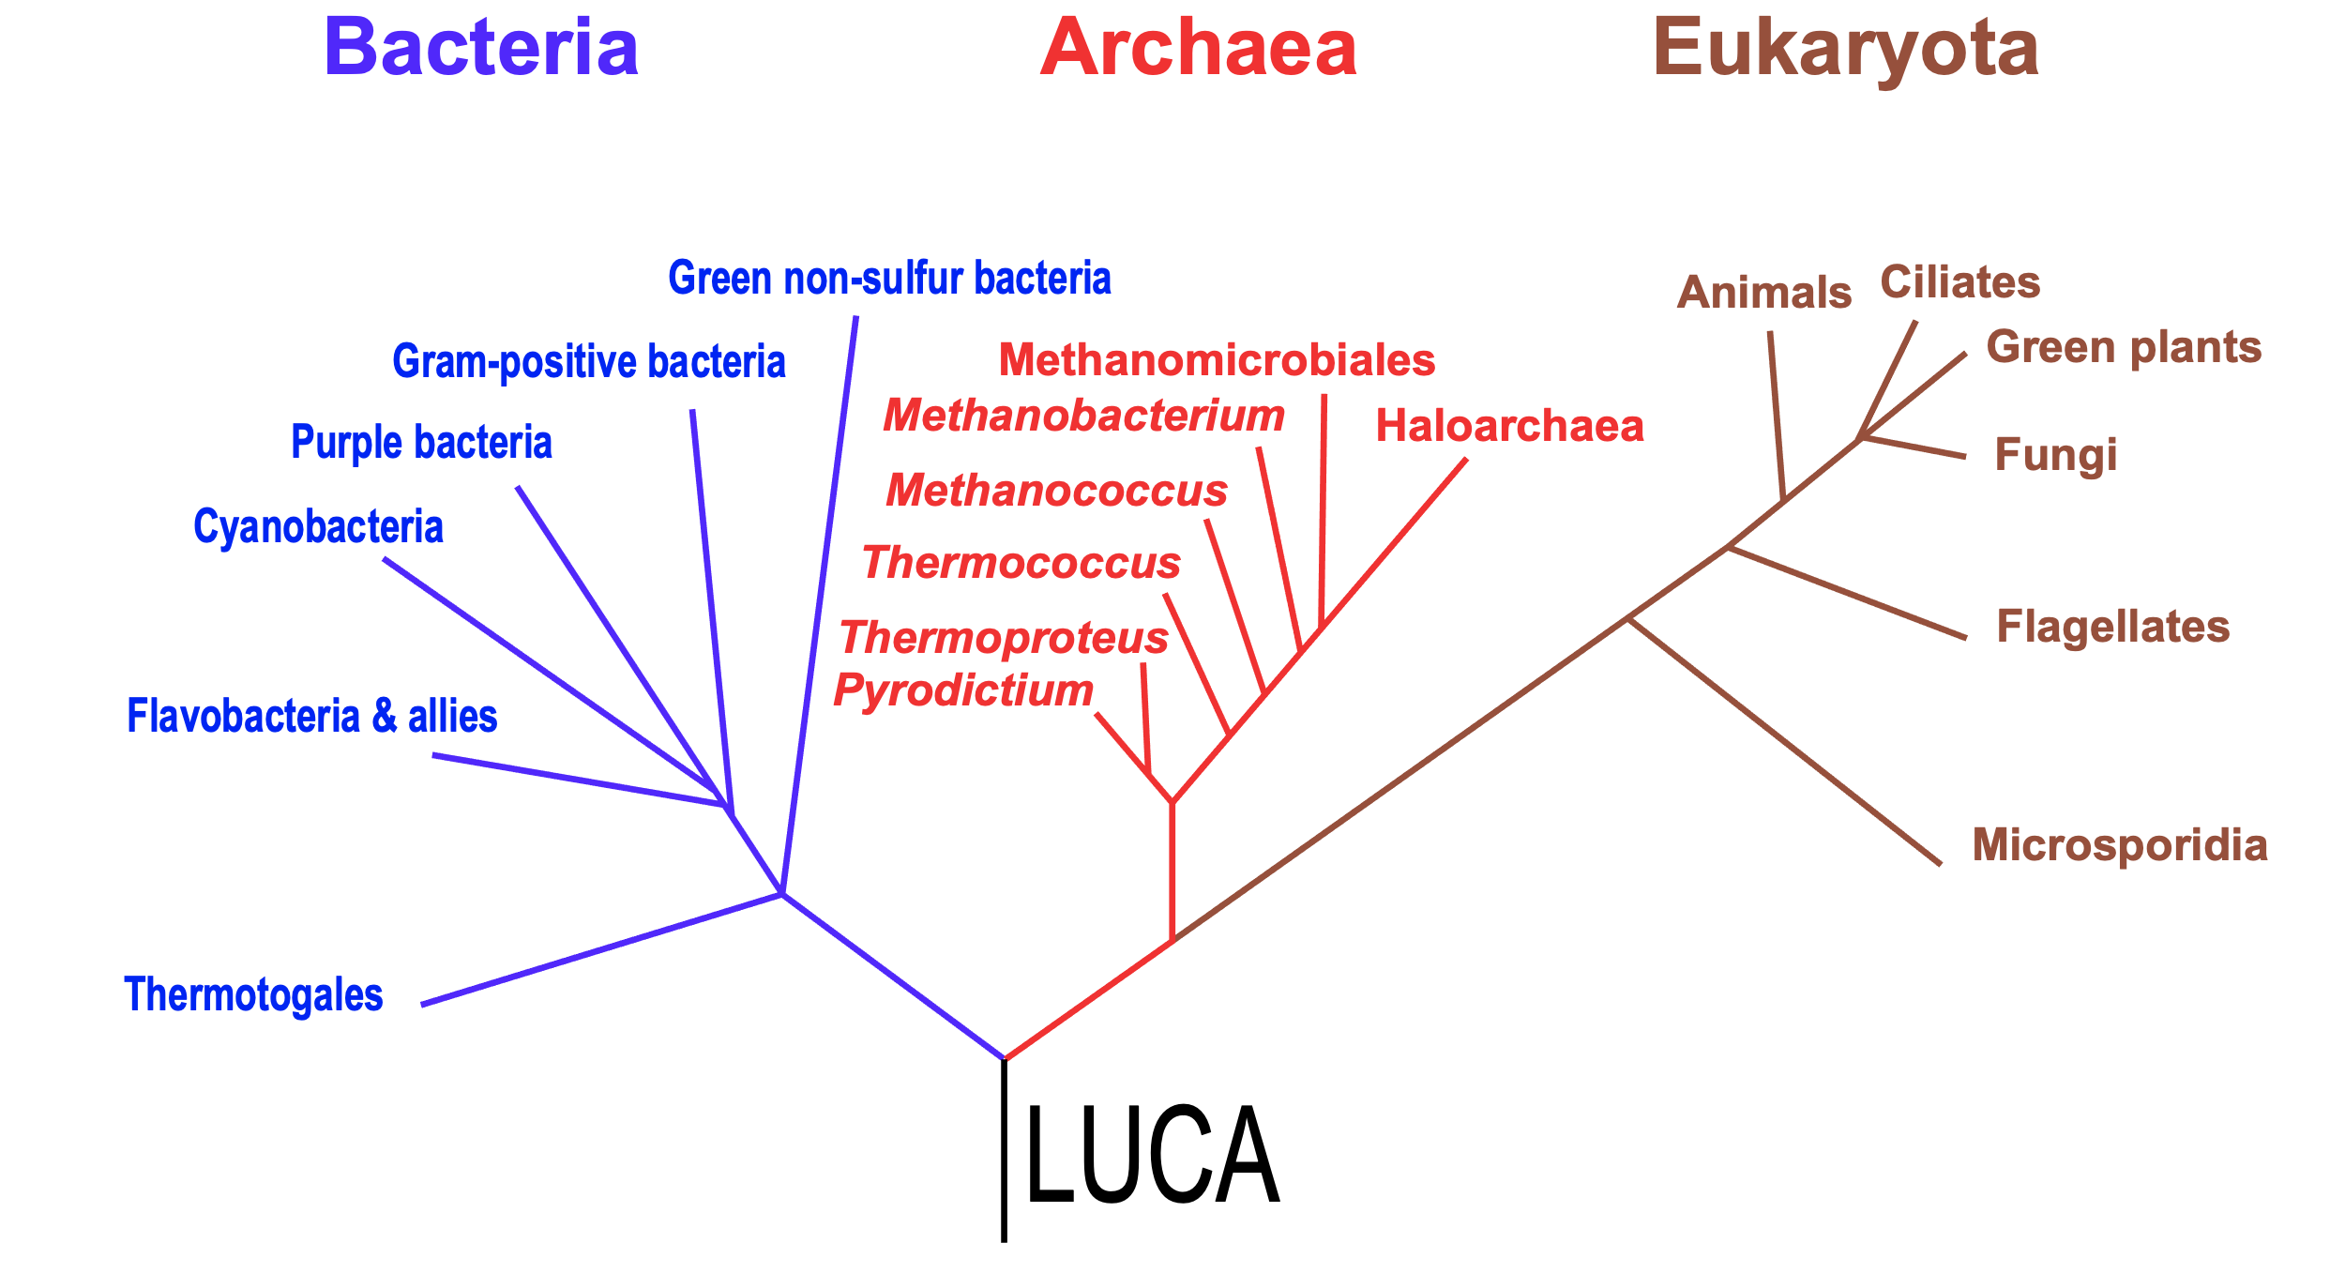
What is not true about LUCA aka the organismal cenancestor.
This organism was the most recent common ancestor of the cellular organisms alive today
All genes found in today’s organisms evolved from genes also present in LUCA
Other organisms lived at the same time as LUCA and these also contributed genes to modern cellular organisms.
Different genes trace there lineage back to molecular most recent common ancestors. The molecular LUCAs did not all exist in the organismal LUCA, nor did they all exist at the same time.
LUCA used 20 genetically encoded amino acids and energy coupling membranes

Slide 8
How are trees of life found in the religion and the philosophy of many different cultures (1) different from evolutionary tree (2)?
A) Trees of life (1) usually are not intended to depict shared ancestry
B) Only evolutionary trees (2) do accurately depict diversity
C) Both types of tree have been used to classify organisms.
D) A, B, and C are correct
E) Only A and C are correct
Q 1
Notes:
A, B, and C are correct

Slide 9
How are family genealogies or pedigrees different or similar from a tree depicting species evolution?
In a genealogy an individual node has many ancestor, in an evolutionary tree one species can have many decedents.
Both depict the ancestry of either an individual or a species
In both cases only a subset of genetic information is passed from parent or parent species to the next generations / descendent species
A, B and C is correct
A, B is correct
Q 2
Notes:
A, B and C is correct

Slide 10
Ford Doolittle, one of my fellow horsemen of the gene transfer apocalypse, published this sketch of phylogenetic relations.
What do you think this image tries to communicate?
Different groups of organisms were not derived from single ancestors
The Last Universal Common Ancestor was not a single organism, but a population
A single tree doesn’t give a good description of evolutionary history.
A and C are correct.
All of the above.
Notes:
All of the above.

Slide 11
What is not true about LUCA aka the organismal cenancestor.
This organism was the most recent common ancestor of the cellular organisms alive today
All genes found in today’s organisms evolved from genes also present in LUCA
Other organisms lived at the same time as LUCA and these also contributed genes to modern cellular organisms.
Different genes trace there lineage back to molecular most recent common ancestors. The molecular LUCAs did not all exist in the organismal LUCA, nor did they all exist at the same time.
LUCA used 20 genetically encoded amino acids and energy coupling membranes

